Slide 1
5th Grade Promotion
June 12, 2020

Slide 2
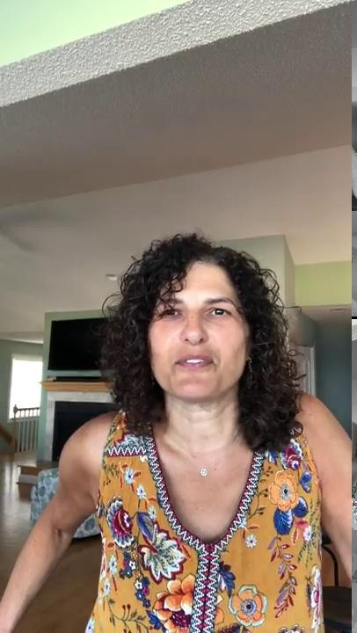
Mrs. Brewer’s Remarks

Slide 3
5th Grade Video: Then and Now

Slide 5
5th Grade Clap Out

